Slide 1



PRODUCT LAUNCHING
January 30, 2026

Slide 2




COMPANY PROFILE
RMC2
CONSULTANCY CORP
Your trusted partner in Health, Life and Non-Life Coverage
www.rmc2consultancycorp.com

Slide 3


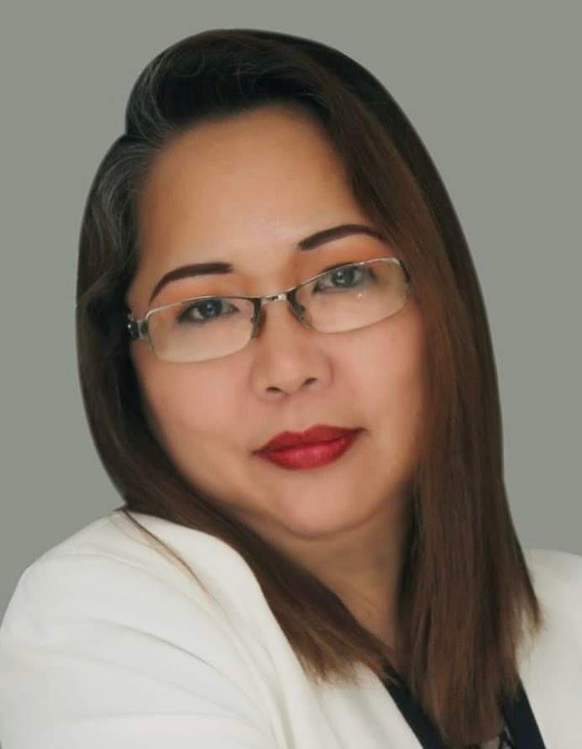
WHO WE ARE
At RMC2 Consultancy Corp, we believe that health and financial security should be accessible to everyone. Founded by Rosemarie Fernandez, who has been in the insurance industry for over 23 years, RMC2 was established with a passion for making a difference. Rosemarie has been exposed to the various needs of the market and decided to create a bridge for Filipinos who are overwhelmed by the process of insurance, making it more accessible and understandable.
We specialize in providing affordable, convenient, and reliable HMO, Life, and Non-Life Insurance solutions tailored to meet diverse needs.
Our mission is simple: to bridge the gap between people and quality healthcare by offering plans that prioritize accessibility and peace of mind. We understand that navigating insurance options can be overwhelming — that's why we take pride in guiding our clients every step of the way, ensuring clarity, compassion, and personalized service.
With a commitment to building lasting relationships, RMC2 Consultancy Corp stands as a trusted partner in safeguarding the well-being and future of individuals, families, and businesses alike.
Let us help you protect what matters most.

Slide 4

ABOUT US
At RMC2, we are dedicated to redefining the insurance experience. We specialize in providing HMO, Life, and Non-Life Insurance solutions that put people first, ensuring that protection isn’t just a privilege but a right for all. Our approach is built on three core principles: Affordability, Accessibility, and Convenience.
We understand that navigating insurance can feel overwhelming, so we’ve made it our mission to simplify the process. From personalized plans to hassle-free assistance, we’re here every step of the way, helping individuals, families, and businesses secure their future with peace of mind.
At the heart of RMC2 is a commitment to building lasting relationships. Whether it’s ensuring quick access to healthcare or offering life protection tailored to your needs, we’re more than just an insurance provider.
We are your trusted partner in safeguarding what matters most which is protecting lives and empowering futures.

Slide 5

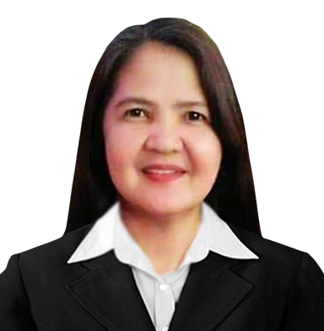
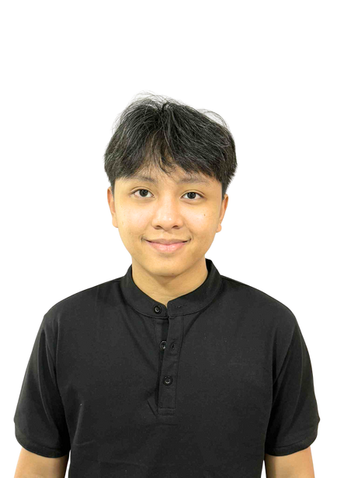

THE MANAGEMENT
ROSEMARIE FERNANDEZ
PRESIDENT & CEO
MICHELLE GUINTO
CHERRY CORTEZ
CLEMENT DOLF FERNANDEZ
CHARLES MARK UYBENGKEE
BOARD OF DIRECTOR
BOARD OF DIRECTOR
BOARD OF DIRECTOR
BOARD OF DIRECTOR

Slide 6

VISION
& MISSION
V > To break barriers where quality health and life protection is within everyone’s reach, ensuring affordability and accessibility for all.
M > To safeguard lives by delivering affordable and accessible HMO, Life, Non-Life Insurance solutions, ensuring everyone has the security and care they deserve.

Slide 7


OUR GROWING NETWORK
RMC2 CONSULTANCY CORP
A growing consultancy firm for insurance solution with a strong client network, committed to promoting wellness, preventive health, and lifestyle benefits for its members.
1,200
15,300
900
SALES ADVISORS
GROUP ENROLLEES
INDIVIDUAL ACCOUNT
*DATA FROM
SEPTEMBER 2024 - NOVEMBER 2025

Slide 8

OUR
OFFICES
LUZON:
Cainta - HEAD OFFICE
Antipolo
Taytay
Bulacan
Valenzuela
Lipa
Pampanga - OPENING SOON
La Union
Baguio
Isabela
Bicol - OPENING SOON
Quezon City 1 & 2
Ilagan
VISAYAS:
Mandaue City - REGIONAL HEAD OFFICE
Cebu City - OPENING SOON
MINDANAO:
General Santos City

Slide 9



OUR NETWORK PROVIDER
Nationwide hospital and clinic accreditation thru our network provider AMAPHIL
AMAPHIL, or Advanced Medical Access Philippines, Inc., is a technology-powered Third Party Administrator (TPA) that was founded in 2016 to manage self-funded corporate health plans. It connects members to a large network of accredited hospitals, clinics, and physicians, and provides technology-driven services like online consultations via the Doctor Anywhere app. AMAPHIL's goal is to provide cost-effective, high-quality healthcare solutions for companies and their employees
www. amaphil.com.ph

Slide 10

SIMPLE BUT IMPORTANT
BE PREPARED
EARN BY HELPING OTHERS

Slide 11
THIS IS WHAT
KAAGAPAY
IS ALL ABOUT

Slide 12

₱1,499
ONE-TIME USE
1 YEAR
NATIONWIDE

Slide 13



15
DAYS OLD
70
YEARS OLD
ELIGIBLE TO AVAIL

Slide 14
15 DAYS OLD TO 59 YEARS OLD
₱10,000.00
60 TO 70 YEARS OLD
₱5,000.00

Slide 15
REASONABLE AND CUSTOMARY MEDICAL EXPENSES

Slide 16
ILLNESS
BODILY INJURY
PRE-EXISTING
CONDITIONS

Slide 17
EMERGENCY COVERAGE
Professional fees of a licensed and qualified medical practitioner
emergency room facility and service fees
medications administered for immediate stabilization and emergency treatment
whole blood and human blood products when medically indicated
oxygen therapy and intravenous fluids
sutures, dressings, splints, and plaster casts
laboratory tests, imaging (x-ray), and diagnostic procedures directly related to emergency evaluation and management
anti-rabies vaccine (first passive dose only)
anti-venom serum (first passive dose only)
anti-tetanus vaccine

Slide 18
QUALIFIED EMERGENCY CONDITION
Serious jeopardy to the member’s life
Serious impairment of bodily functions
Serious dysfunction of any body organ or part

Slide 19
QUALIFIED EMERGENCY CONDITIONS
Uncontrolled or sever bleeding
Coughing up or vomiting blood
Persistent or severe vomiting
Choking or Airway Obstruction
Acute respiratory distress, difficulty breathing or shortness of breath
Chest pain or symptoms suggestive of a cardiac event.
Accidental ingestion, injection or exposure to toxic or poisonous substances
Sudden onset of altered mental status, confusion or disorientation.
Fainting, syncope or loss of consciousness
Acute head, neck or spinal injury.
Traumatic injuries resulting from vehicular accidents, falls, burns, smoke inhalation, near drowning or deep and extensive wounds
Sudden onset of dizziness, weakness, numbness or visual disturbances.
Sudden and severe pain of unknown origin affecting any part of the body.
Sudden and severe abdominal pain or pressure.

Slide 20
15-DAY WAITING PERIOD

Slide 21
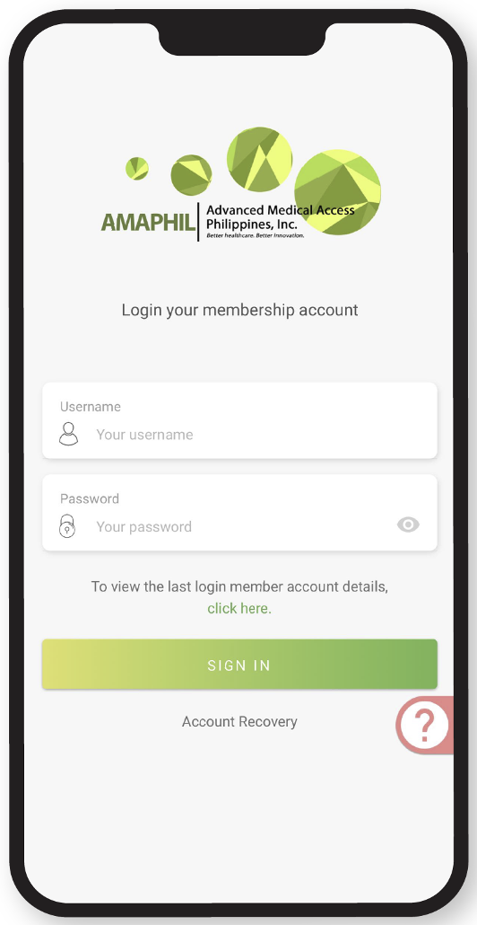
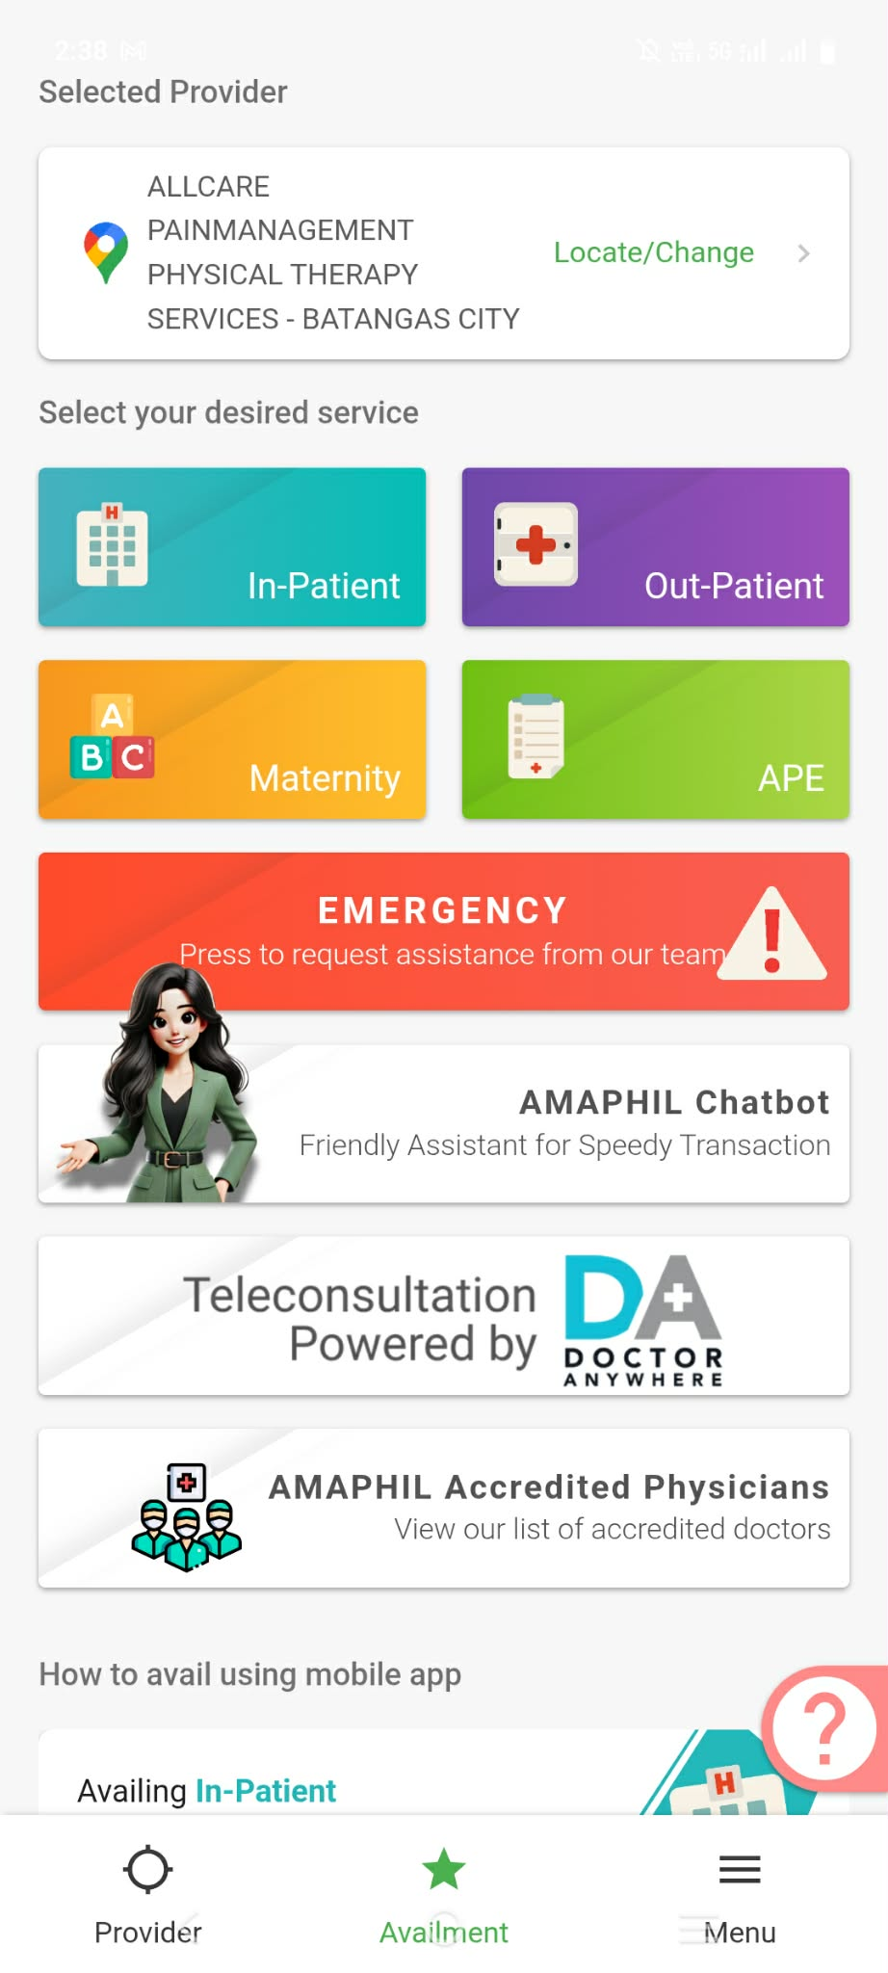
Emergency (ER) Availment Process

Slide 22








Emergency (ER) Availment Process
Member goes to accredited hospital
Member reports his ER using his AMAPHIL mobile app to the ER Dept
Member is treated
Member to pay the excess (if applicable) to the hospital
AMAPHIL issues LOA based on the member’s benefit
Once ready for discharge and billing, hospital staff calls AMAPHIL to report the ER and request for LOA.

Slide 23

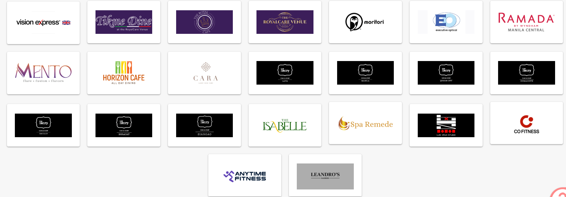
PARTNERSHIP PERKS

Slide 24



Slide 25
Why choose KAAGAPAY?
Affordable emergency protection for only ₱1,499
Nationwide availability through affiliated and public hospitals
Coverage for sudden illnesses and accidents, including emergencies related to
pre-existing conditions
Clear and defined emergency benefits, aligned with medical and insurance standards
Simple and easy-to-understand coverage, ideal for individuals and families

Slide 26
A RELIABLE EMERGENCY SUPPORT
KAAGAPAY MO SA ORAS NG
EMERGENCY

Slide 27
EXCITING PART!!!

Slide 28

EXCITING PART!!!
OPPORTUNITY TO EARN

Slide 29






KAAGAPAY MEMBER
EXTRA INCOME

Slide 30
STRUCTURED
INCENTIVE PROGRAM

Slide 31
2 WAYS TO EARN INCENTIVES
FROM YOUR OWN SALES (DIRECT SALES – LEVEL 1)
FROM THE SALES OF YOUR NETWORK (LEVELS 2 TO 5)

Slide 32

Earn 5-10% Direct Sales Incentive
AS YOUR REFERRALS GROW, YOUR EARNING POTENTIAL ALSO INCREASES

Slide 33


OWN SALES (DIRECT SALES – LEVEL 1)
1
2
3
4
5
6
7
8
9
10
11
12
13
14
15
5%
5%
5%
5%
5%
5%
5%
5%
5%
5%
5%
5%
5%
5%
5%
• 1ST TO 15TH SALE: 5% INCENTIVE (ABOUT ₱75 PER ACCESS)
• 16TH TO 30TH SALE: 7.5% INCENTIVE (ABOUT ₱112 PER ACCESS)
• 31ST SALE ONWARD: 10% INCENTIVE (ABOUT ₱150 PER ACCESS)

Slide 34
SAMPLE DIRECT EARNINGS
10 SALES → AROUND ₱750
20 SALES → AROUND ₱1,685
35 SALES → AROUND ₱3,560
THE MORE YOU SHARE
THE MORE YOU EARN

Slide 35
Earn 1% Network Sales Incentive
AS YOUR NETWORK GROW, YOUR EARNING POTENTIAL ALSO INCREASES

Slide 36
FROM THE SALES OF YOUR NETWORK (LEVELS 2 TO 5)
IF EACH LEVEL SELLS 10 ACCESS, YOU EARN:
• LEVEL 2: ₱150
• LEVEL 3: ₱150
• LEVEL 4: ₱150
• LEVEL 5: ₱150
TOTAL OF ₱600

Slide 37
LEVEL 1
₱1,685
LEVEL 2
LEVEL 3
₱600
LEVEL 4
LEVEL 5
TOTAL INCENTIVE = ₱2,285

Slide 38
WHAT MAKES KAAGAPAY SPECIAL?
EARN INCOME
HELPING FAMILIES

Slide 39
INCENTIVE RELEASE POLICY
✓ Incentive requests may be filed anytime through the RMC2 KAAGAPAY EMERGENCY ACCESS PORTAL.
✓ Requests filed from the 1st to the 15th of the month will be credited on the 20th of the same month.
✓ Requests filed from the 16th to the end of the month will be credited on the 5th banking day of the following month.
✓ If the release date falls on a weekend or holiday, it will be moved to the next banking day.

Slide 40
WITHDRAWAL & FEES
✓ Minimum withdrawal: ₱500.00 per request
✓ Maximum withdrawal: ₱50,000.00 per request
✓ Service fee: ₱50.00 per request (processing and transfer fee)
✓ Multiple requests are allowed, subject to the cutoff schedule

Slide 41
IN SUMMARY
✓ KAAGAPAY provides emergency support
✓ You earn from your own referrals ✓ You earn more as your team grows ✓ Earnings can go up to 5 levels
✓ You can also enjoy exclusive discounts and privileges through our
Partnership Perks.

Slide 42
SECURE YOUR HEALTH.
UNLOCK EARNING POTENTIAL.

Slide 43
Thank YOU!

